Slide 1
CPE 133
Signed Binary Number Representations
Signed Binary Addition/Subtraction
Example Design Problems

Slide 2
Foundation Modules (thus far)
RCA
Generic Decoder
Standard Decoder

Slide 3
2:4 Standard Decoder
module dcdr_standard_1a(sel, data_out);
input [1:0] sel;
output reg [3:0] data_out;
always @(sel)
begin
if (sel == 0) data_out = 4'b0001; //- one-hot
else if (sel == 1) data_out = 4'b0010;
else if (sel == 2) data_out = 4'b0100;
else if (sel == 3) data_out = 4'b1000;
else data_out = 4'b0000;
end
endmodule

Slide 4
2:4 Standard Decoder
module dcdr_standard_1b(sel, data_out);
input [1:0] sel;
output reg [3:0] data_out;
always @(sel)
begin
case (sel)
0: data_out = 4'b0001; //- one hot output
1: data_out = 4'b0010;
2: data_out = 4'b0100;
3: data_out = 4'b1000;
default data_out = 4'b0000;
endcase
end
endmodule

Slide 5
2:4 Standard Decoder
module dcdr_standard_3(s1, s0, data_out);
input s1,s0;
output reg [3:0] data_out;
always @(s1,s0)
begin
case ({s1,s0})
0: data_out = 4'b0001;
1: data_out = 4'b0010;
2: data_out = 4'b0100;
3: data_out = 4'b1000;
default data_out = 0;
endcase
end
endmodule

Slide 6
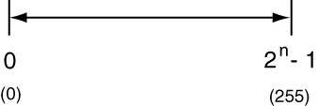
Unsigned Binary Numbers
The only thing we’ve been working with
n = number of bits (n=8 for this example)

Slide 7
Signed Binary Numbers
Sign Bit (always left-most bit)
Signed Binary Number Flavors
SM – sign magnitude
DRC – diminished radix complement
RC – radix complement (2’s complement)
For each
Find decimal equivalent
Multiply by -1 (change the sign)
n-bit number range
2’s complement trick

Slide 8
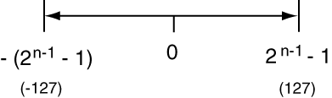
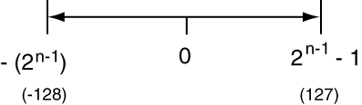
Number Ranges (drawn to scale)
Unsigned binary
Signed binary SM & DRC
Signed binary RC

Slide 9
Binary Subtraction & Addition
Addition: 1011 + 0111
Subtraction:
Indirect subtraction by addition
N1-N2 = N1 + (-N2)
Valid or not Valid result of signed operation?
Super straight-forward
Result is not valid if outside of given range
Invalid: add two number of same sign and get result of different sign

Slide 10
Examples
For the following set of mathematical operations, demonstrate the operation in detail and state whether the result is valid or not.
0011 + 0010
0100 – 1110
0100 – 1100
0100 – 0011

Slide 11
Design Problem Example 1
Design a circuit that multiples an 8-bit number in RC format by -1 (changes sign)
Show top two levels of BBD
State how circuit is controlled

Slide 12
Design Problem Example 2
Design a circuit that has two 10-bit inputs. The output of the circuit shows the 10-bit result of the sum of the two inputs. The circuit has another output that indicates if the addition result is valid. The inputs and result output are in unsigned binary format.
Show top two levels of BBD
State how circuit is controlled

Slide 13
Design Problem Example 3
Design a circuit that has two 10-bit inputs. The output of the circuit shows the 10-bit result of the sum of the two inputs. The circuit has an output that indicates if the result is valid. The inputs and result output are in RC format.
Show top two levels of BBD
State how circuit is controlled

